Slide 1

IOT End Semester Assessment SEM II 2023-2024
Automatic Solar Plate Tracker and Cleaner
Division: CS-C Group_ID: CS-C B2 Date: 03-04-2024
Department of Multidisciplinary Engineering
Vishwakarma Institute of Technology, Pune
SEM II A.Y.(2023-2024)
PRESENTED BY:
Vedant Mohol (27)
Moin Khan (28)
Aditya Narsale (34)
Samarth Otari (42)
Palaash Padman (44)
GUIDE : PROF. ANIL KADU
Vishwakarma Institute of Technology

Slide 2
CONTENT
Introduction
Problem Statement
Objectives
Methodology
Components
Results
Advantages
Disadvantages
Future Scope
Vishwakarma Institute of Technology

Slide 3
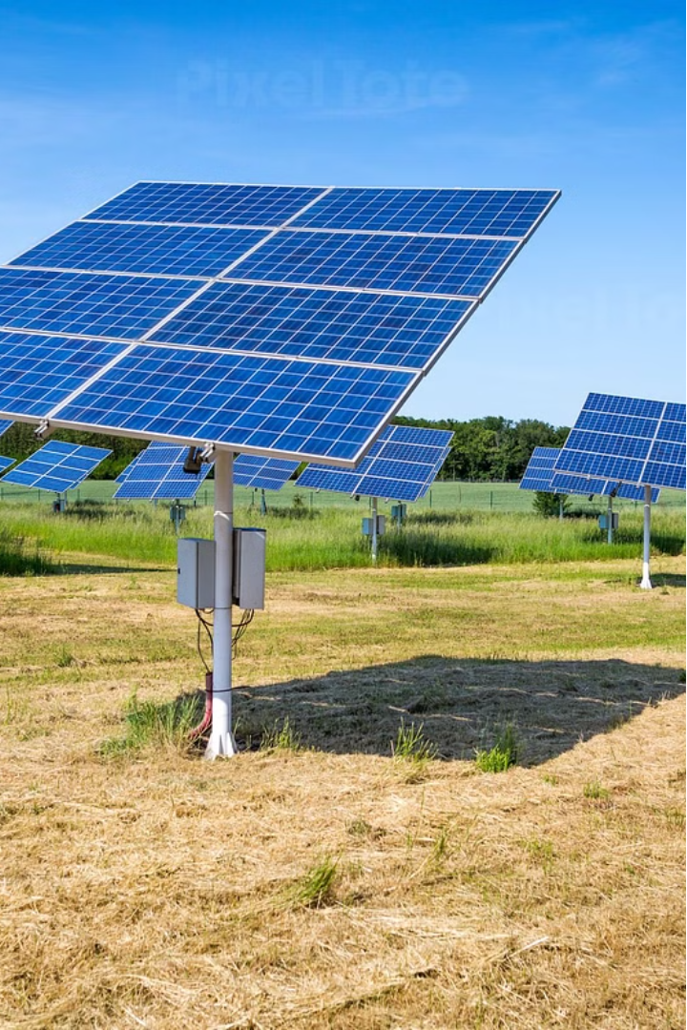

Automatic Solar Plate Tracker and Cleaner

Slide 4
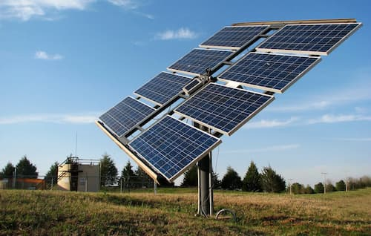
Introduction
Implement intelligent tracking algorithms that continuously monitor the sun's position and adjust solar panel orientation accordingly, optimizing energy capture throughout the day
Integrate automated cleaning mechanisms within the solar panel system to remove dirt, dust, and other debris regularly, maintaining peak efficiency and prolonging the lifespan of the panels

Slide 5
Problem Statement
Solar panels often suffer from reduced efficiency due to suboptimal sun tracking and accumulation of dirt, dust, and debris on their surface. Manually adjusting the panels and cleaning them regularly is time-consuming and costly. An automated solution is needed to address these problems and improve the overall performance of solar energy systems.

Slide 6
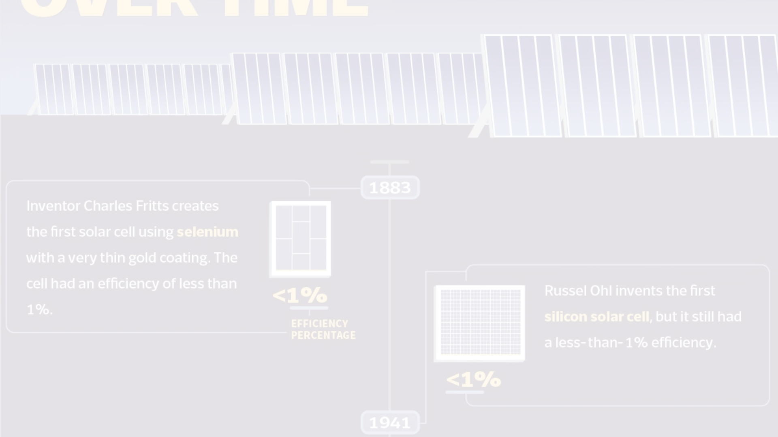
Objectives
1
Maximize Solar Energy Generation
2
Maintain Panel Cleanliness
3
Monitor System Performance
Improve the efficiency of solar panels by automatically adjusting their orientation to track the sun's position.
Implement a cleaning system to regularly remove dirt, dust, and debris from the solar panel surface.
Utilize a voltage sensor to track the panel's output and ensure optimal energy generation.

Slide 7
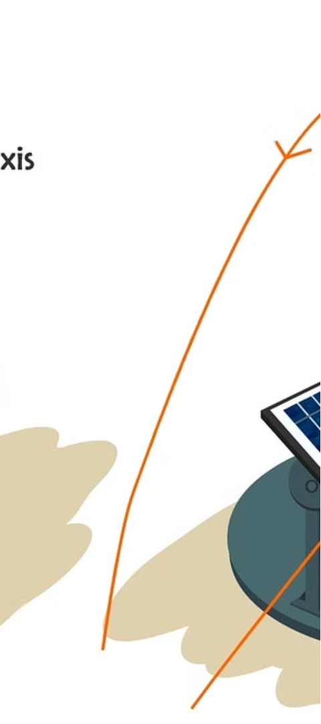
Methodology
1
Sun Tracking
Use light-dependent resistor (LDR) sensors to detect the sun's position and adjust the panel orientation accordingly using a servo motor.
2
Cleaning Mechanism
Implement a wiper system powered by a motor to regularly clean the solar panel surface and remove any accumulated dirt or debris.
3
Voltage Monitoring
Employ a voltage sensor to monitor the panel's output and ensure optimal energy generation.

Slide 8
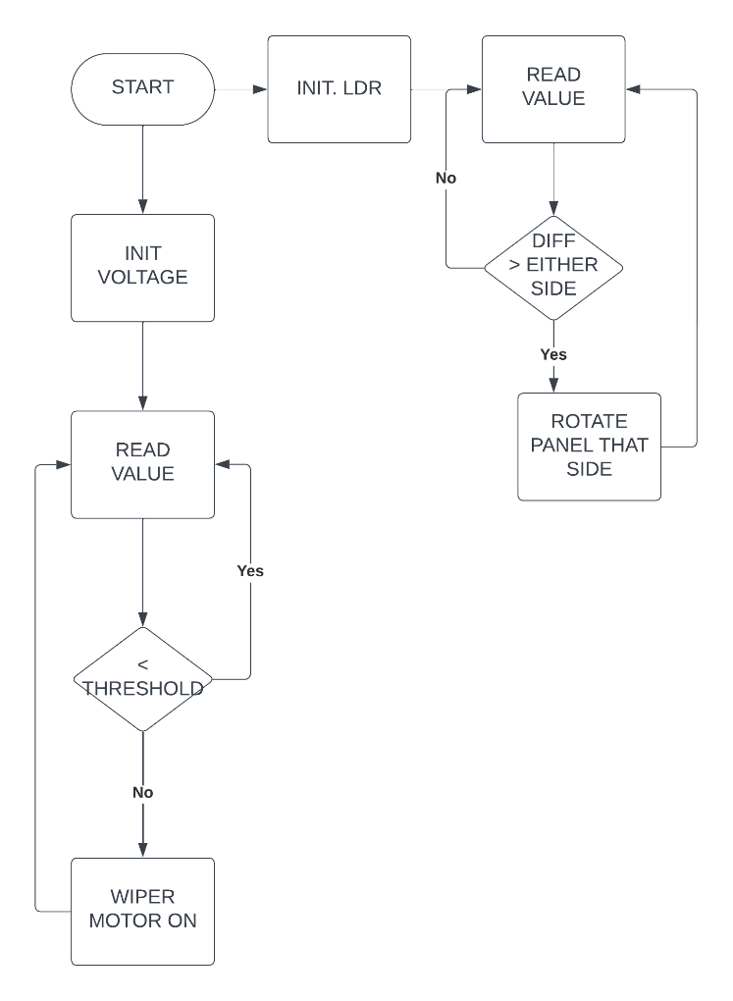
Flowchart

Slide 9
Components Used
Sensors
Actuators
Control
ESP8266 Wi-Fi Module
Servo Motor
Arduino Board
LDR Sensor
Wiper Motor
Voltage Sensor

Slide 10
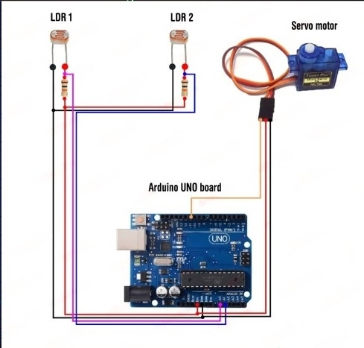
Circuit diagram

Slide 11
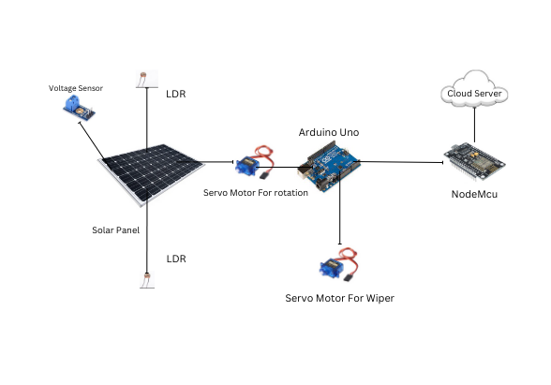
Block diagram

Slide 12
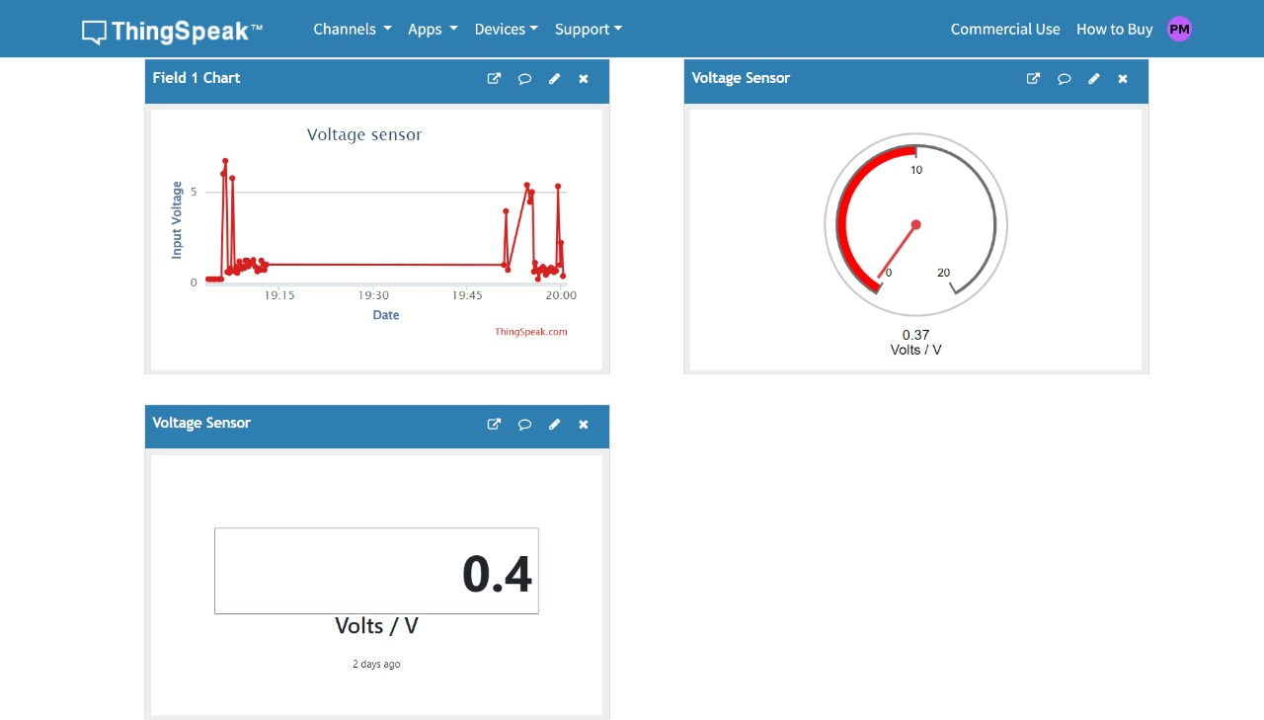
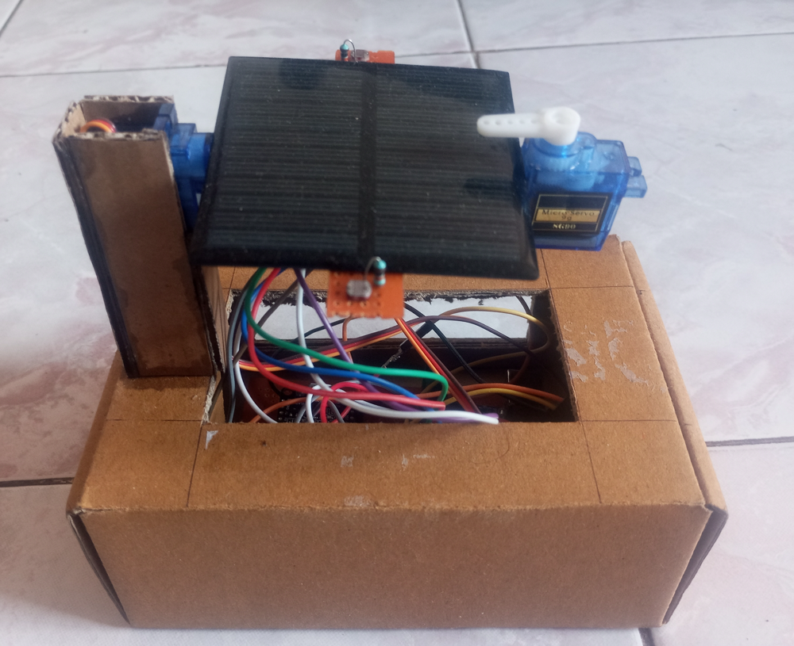

Slide 13
Advantages
Increased Efficiency
Reduced Maintenance
The sun tracking and cleaning features can improve the solar panel's energy.
Automated cleaning eliminates the need for manual panel cleaning, reducing labor and maintenance costs.
Improved Reliability
Cost Savings
Continuous monitoring and optimization of the system ensures optimal performance and reliability.
The improved efficiency and reduced maintenance can lead to significant cost savings over the system's lifetime.

Slide 14



Disadvantages
Higher Initial Cost
Increased Complexity
Power Consumption
The additional sensors, actuators, and control systems required may increase the initial installation cost.
The system's complexity may require more technical expertise for installation and maintenance.
The tracking and cleaning mechanisms may consume some of the generated solar power, reducing net energy output.

Slide 15



Future Scope
Integration with IoT
Integrate the system with IoT platforms to enable remote monitoring, control, and optimization.
Advanced Algorithms
Develop more sophisticated algorithms for sun tracking and panel cleaning to further improve efficiency.
Expanded Applications
Explore the application of this technology in other renewable energy systems, such as wind turbines.

Slide 16
Thank You

